Slide 1

Algebra 1
Unit 9, Lesson 3 Writing a Quadratic Function From a Table Volume 2, pg. 71

Slide 2


Benchmarks
MA.912.AR.1.2
Rearrange equations or formulas to isolate a quantity of interest.
MA.912.AR.3.4
Write a quadratic function to represent the relationship between two quantities from a graph, a written description, or a table of values within a mathematical or real-world context.
volume 2, pg. 71

Slide 3
Integrated Mathematical Thinking and Reasoning Standards
MA.K12.MTR.2.1 Demonstrate understanding by representing problems in multiple ways.
MA.K12.MTR.3.1 Complete tasks with mathematical fluency.
MA.K12.MTR.4.1 Engage in discussions that reflect on the mathematical thinking of self and others.
MA.K12.MTR.5.1 Use patterns and structure to help understand and connect mathematical concepts.
volume 2, pg. 71

Slide 4

Learning Targets
I can write a quadratic function to represent the relationship between two quantities from a table.
I can rewrite a quadratic equation from vertex form to standard form.
I can solve for a variable of interest.
volume 2, pg. 71

Slide 5

Warm-Up
volume 2, pg. 71

Slide 6
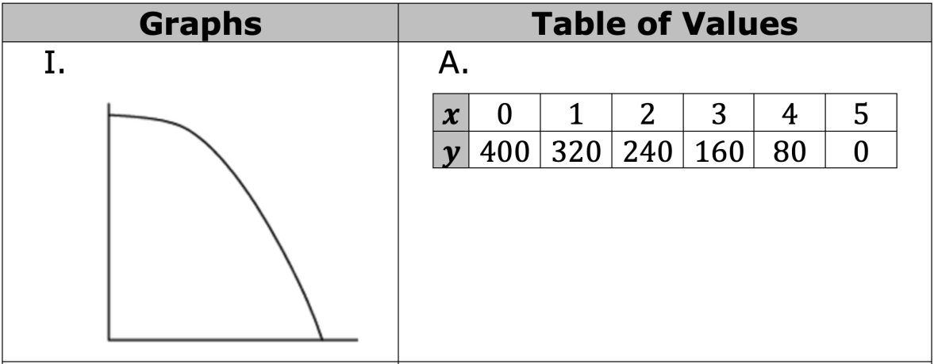
9.3.1 Warm-Up: Words, Tables, and Graphs – Part 1
Match each of the following three graphs with the appropriate table of values.
volume 2, pg. 71
Notes:
Video Link: https://algebranation.wistia.com/medias/fi4fidi5y8

Slide 7
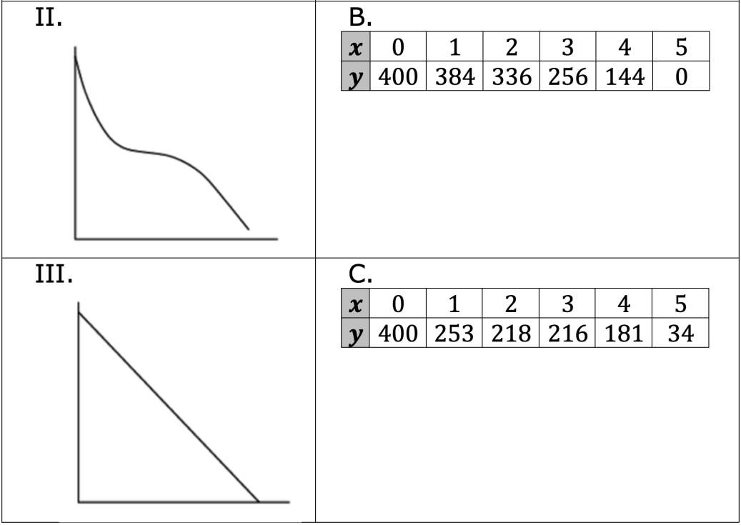
How did you use each table to determine the graph it matched to?
volume 2, pg. 71

Slide 8

Exploration
volume 2, pg. 72

Slide 9

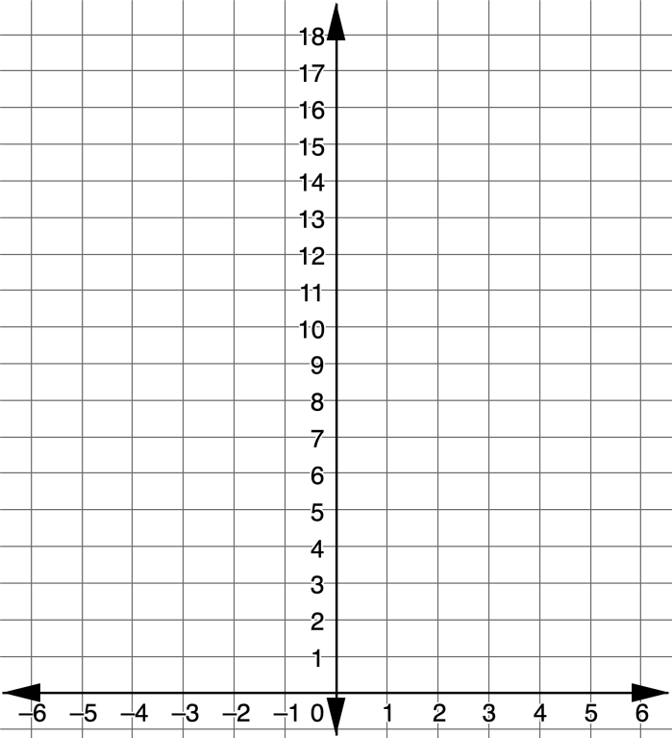
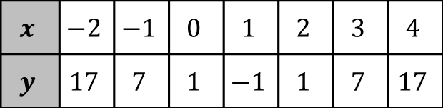
9.3.2 Exploration: Identifying the Vertex From a Table
Plot the points from the table on the graph.
$$x$$ | $$−2$$ | $$−1$$ | $$0$$ | $$1$$ | $$2$$ | $$3$$ | $$4$$
$$y$$ | $$17$$ | $$7$$ | $$1$$ | $$−1$$ | $$1$$ | $$7$$ | $$17$$
volume 2, pg. 72

Slide 10
Label the vertex.
Discuss with your partner what change happens at the vertex in the graph. Summarize your discussion.
volume 2, pg. 72

Slide 11
Thinking of the change that you observed in the graph, review the table and look for a similar change.
Discuss with your partner how the vertex can be identified from the table without plotting the points. Summarize your discussion using the key feature of increasing/decreasing.
volume 2, pg. 72

Slide 12
On the graph, label two points that are equidistant from the vertex.
In the table, draw a square around the two points labeled on the graph.
volume 2, pg. 72

Slide 13
Complete the statement.
Two points that are equidistant from the vertex can be identified by matching points that have the same ...
In the table, circle two additional points that are equidistant from the vertex.
volume 2, pg. 73

Slide 14
Discuss with your partner if there is enough information from the table to write the equation of the quadratic function in vertex form. Justify your choice by explaining your reasoning.
volume 2, pg. 73

Slide 15

Guided Practice
volume 2, pg. 73

Slide 16

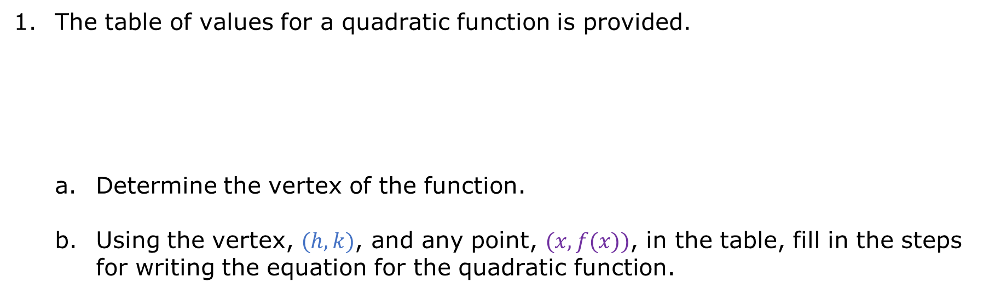
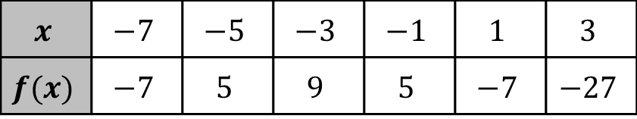
9.3.3 Guided Practice: Writing a Quadratic Function Using a Vertex and Point from a Table
The table of values for a quadratic function is provided.
Determine the vertex of the function.
Using the vertex, $(h, k)$, and any point, $(x,f(x))$, in the table, fill in the steps for writing the equation for the quadratic function.
$$x$$ | $$−7$$ | $$−5$$ | $$−3$$ | $$−1$$ | $$1$$ | $$3$$
$$f(x)$$ | $$−7$$ | $$5$$ | $$9$$ | $$5$$ | $$−7$$ | $$−27$$
volume 2, pg. 73

Slide 17
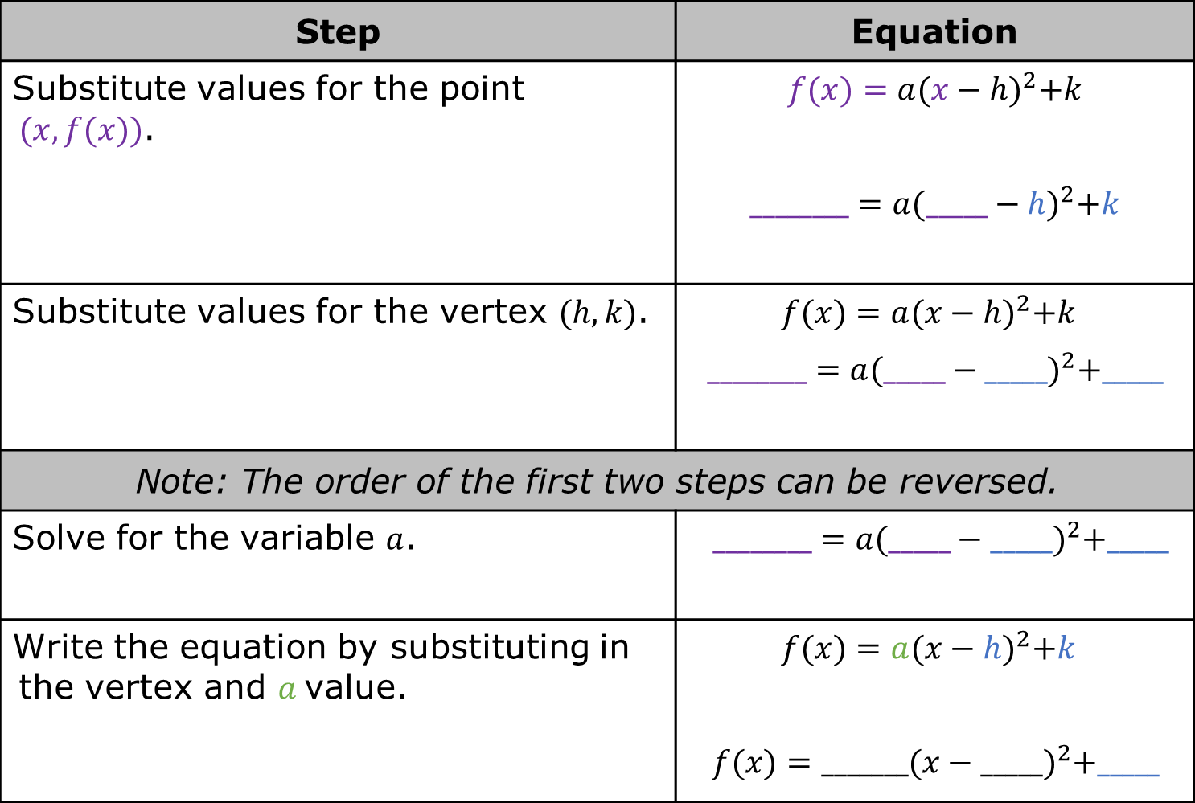
Step | Equation
Substitute values for the point $(x,f(x))$. | $$f(x)=a{(x−h)}^{2}+k$$ $$________=a{(_____−h)}^{2}+k$$
Substitute values for the vertex $(h, k)$. | $f(x)=a{(x−h)}^{2}+k$ $$________=a{(_____−_____)}^{2}+_____$$
Note: The order of the first two steps can be reversed.
Solve for the variable $a$. | $________=a{(_____−_____)}^{2}+_____$
Write the equation by substituting in the vertex and $a$value. | $f(x)=a{(x−h)}^{2}+k$ $$f(x)=_______{(x−_____)}^{2}+_____$$
volume 2, pg. 73

Slide 18
Find a classmate who used a different point for $(x,f(x))$. Compare your equations. Explain why they are the same or why they are different.
volume 2, pg. 74

Slide 19
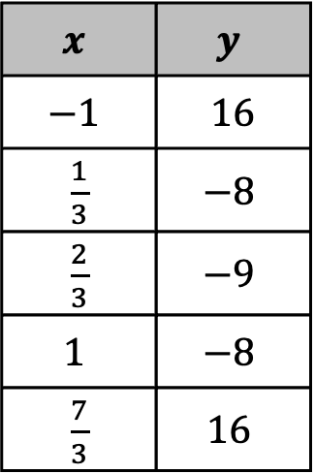
A table of values for a quadratic function is shown.
Identify the vertex of the quadratic function using the table.
Vertex (_____ , _____)
$$x$$ | $$y$$
$$−1$$ | $16$
$\frac{1}{3}$ | $$−8$$
$\frac{2}{3}$ | $$−9$$
$$1$$ | $$−8$$
$\frac{7}{3}$ | $$16$$
volume 2, pg. 74

Slide 20
Check your answer with your partner and discuss what strategy each of you used to identify the vertex. Correct your vertex if needed.
Choose a point from the table, other than the vertex, to create the equation of the quadratic in the function.
(_____ , _____)
volume 2, pg. 74

Slide 21

Determine the 𝑎 value of the quadratic using form $y=a{\left(x−h\right)}^{2}+k$.
Using the vertex and 𝑎 value, write the equation of the function in vertex form.
Rewrite the equation in standard form $y=a{\left(x−h\right)}^{2}+k$.
volume 2, pg. 74

Slide 22
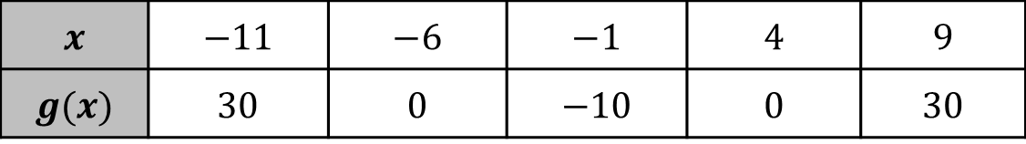
A table of values for the function 𝑔 is shown.
Determine the equation of the function 𝑔. Show your work.
$$x$$ | $$−11$$ | $$−6$$ | $$−1$$ | $$4$$ | $$9$$
$$g(x)$$ | $$30$$ | $$0$$ | $$−10$$ | $$0$$ | $$30$$
volume 2, pg. 75

Slide 23
Give the equation in both vertex and standard form.
Vertex Form
Standard Form
volume 2, pg. 75

Slide 24

Your Turn
volume 2, pg. 75

Slide 25
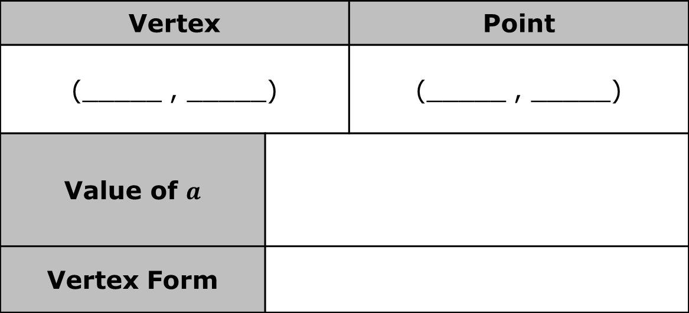
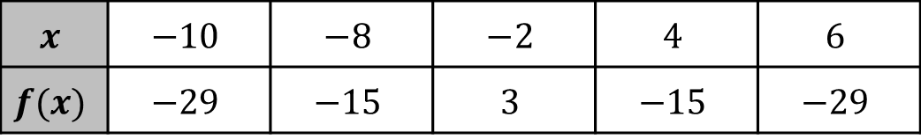
9.3.4 Your Turn!
Write the quadratic equation in vertex form.
$$x$$ | $$−10$$ | $$−8$$ | $$−2$$ | $$4$$ | $$6$$
$$f(x)$$ | $$−29$$ | $$−15$$ | $$3$$ | $$−15$$ | $$−29$$
Vertex |  | Point
(_____ , _____) |  | (_____ , _____)
Value of $a$
Vertex Form
volume 2, pg. 75

Slide 26
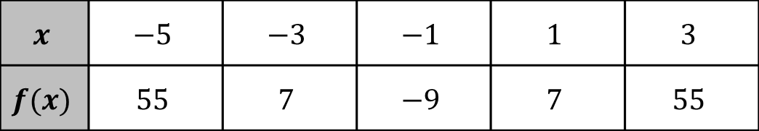
Write the quadratic equation in vertex and standard form for the quadratic function using the table.
$$x$$ | $$−5$$ | $$−3$$ | $$−1$$ | $$1$$ | $$3$$
$$f(x)$$ | $$55$$ | $$7$$ | $$−9$$ | $$7$$ | $$55$$
Vertex Form
Standard Form
volume 2, pg. 76

Slide 27

Wrap-Up
volume 2, pg. 76

Slide 28
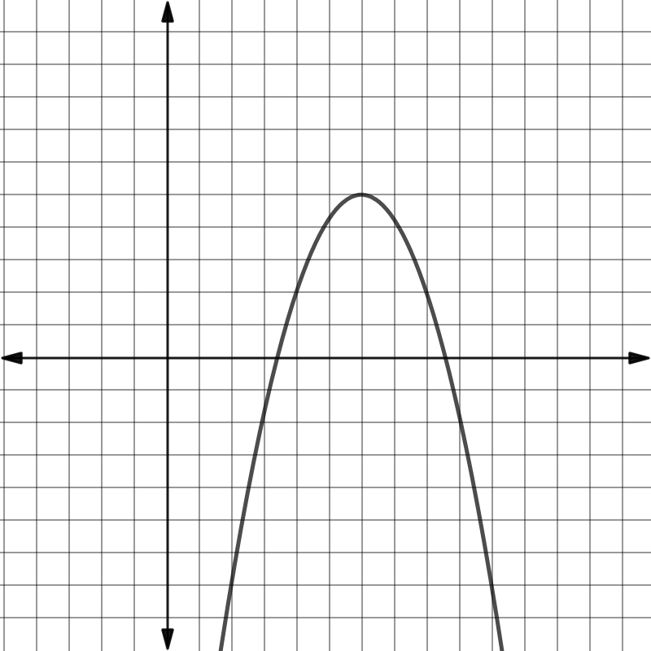
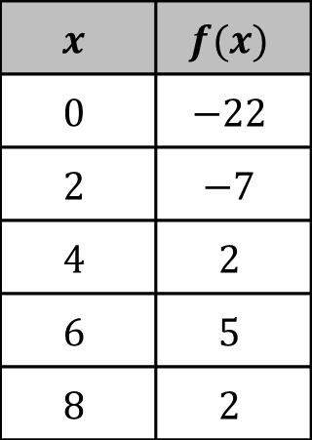
9.3.5 Wrap-Up: Ticket Out the Door
Write the equation for the quadratic function in vertex and standard form.
$$x$$ | $$f(x)$$
$$0$$ | $$−22$$
$$2$$ | $$−7$$
$$4$$ | $$2$$
$$6$$ | $$5$$
$$8$$ | $$2$$
Vertex Form
Standard Form
volume 2, pg. 76

